Slide 1

Health and biodiversity in the era of data-driven research

Slide 2

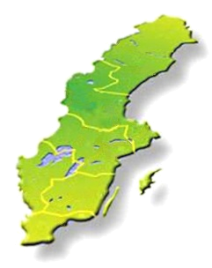

SciLifeLab platforms
SciLifeLab national service
VR
National Genomics Infrastructure
Clinical Diagnostics
Single-cell Biology
National Bioinformatics Infrastructure
Sweden
SNIC
Bengt Persson
Computer resources free for Swedish researchers

Slide 3

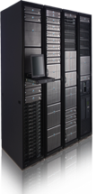
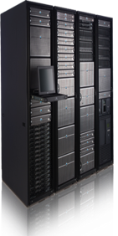

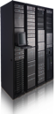
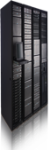
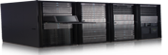





NBIS - Support, Tools and Training
400 consultations
Future storage infrastructure
>1600 compute projects
>800 software and databases
30 training events
500 PhD/post-docs
Data publishing and open science
Secure sharing of sensitive data
200 research projects
Efficient tools and workflows

Slide 4
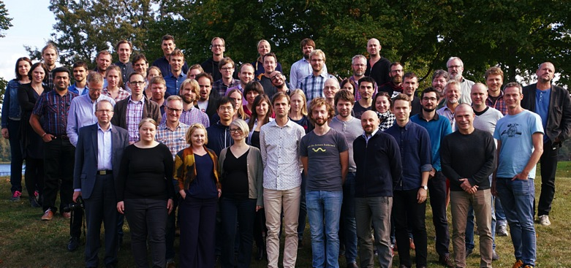
Evaluation, Research Council
SciLifeLab Bioinformatics (NBIS) and Genomics (NGI) were both top-ranked in the most recent VR evaluation.
“NBIS is probably the largest genuinely national and fully established bioinformatics infrastructure in Europe.” “[NBIS..] is crucial to the future competitiveness of Sweden in data-driven life sciences research, and is helping to keep Sweden in the European forefront in the area.”
Scientific impact: 7/7 (“Outstanding”)
Overall score: 7/7 (“Outstanding”)

Slide 5
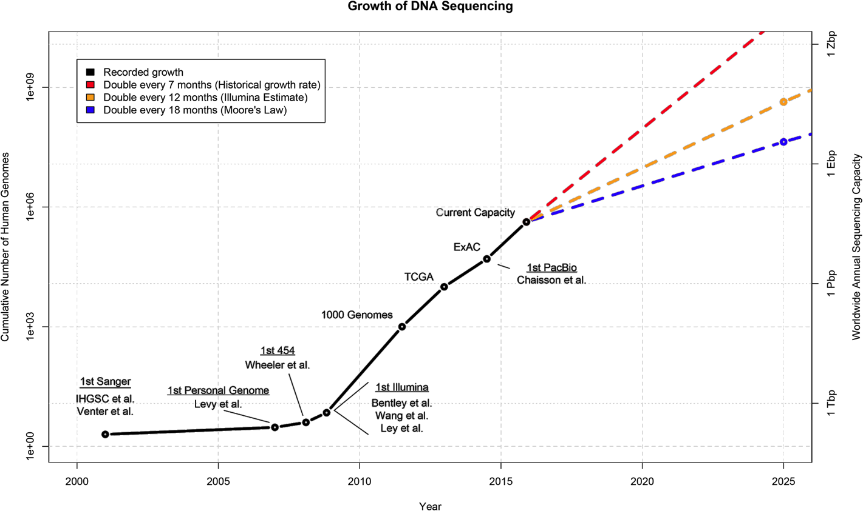
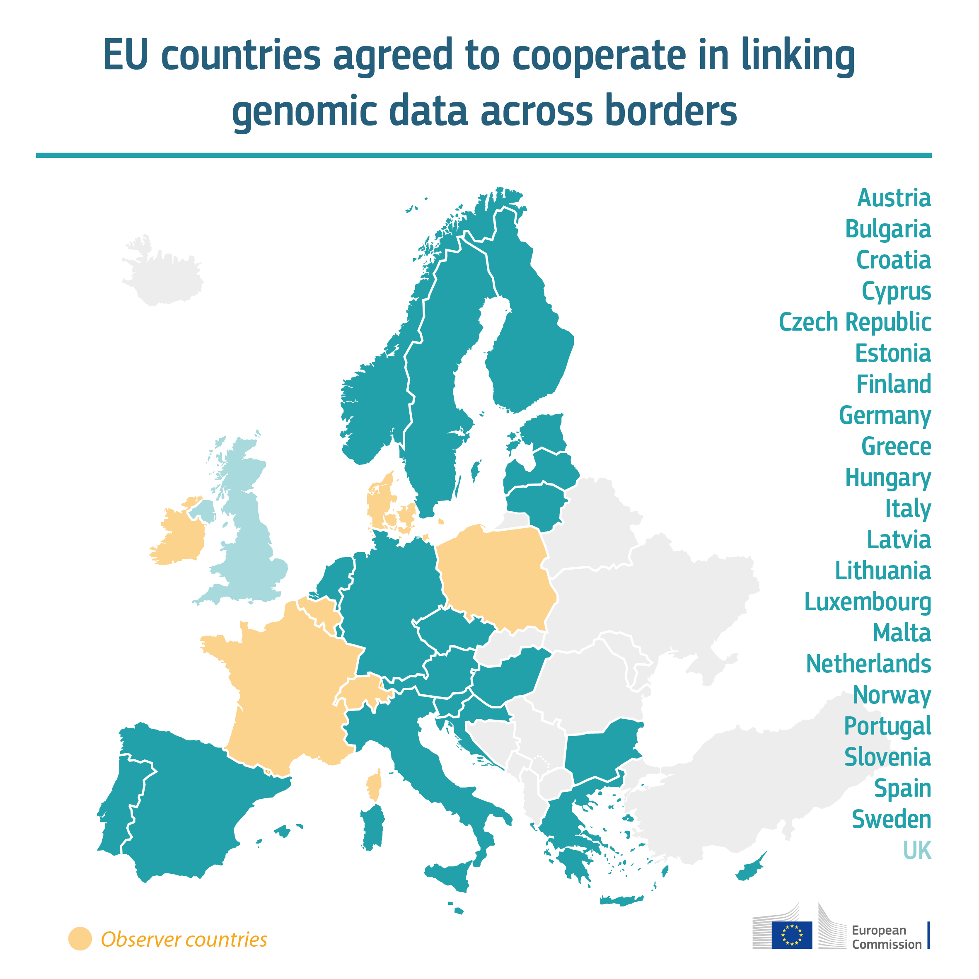
Data growth
First human genome: 13 years
SciLifeLab 2016: 1 h
“One million genomes accessible in the EU by 2022”
Stephens ZD, Lee SY, Faghri F, Campbell RH, Zhai C, et al. (2015) Big Data: Astronomical or Genomical? PLoS Biol 13:e1002195 doi:10.1371/journal.pbio.1002195, http://127.0.0.1:8081/plosbiology/article?id=info:doi/10.1371/journal.pbio.1002195
Notes:
Zettabyte: 10^21

Slide 6
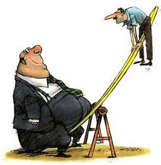
Production is cheap, analysis is not
Cost
Cost
Bioinformatics analyses
Computing
Data
Data
Year
Year
“Per base”
“Per project”
.
NBIS role
We want to help the Swedish Life Science community to build knowledge in large-scale data analysis, and to make bioinformatics easily accessible for all.
Data scientists
Data

Slide 7
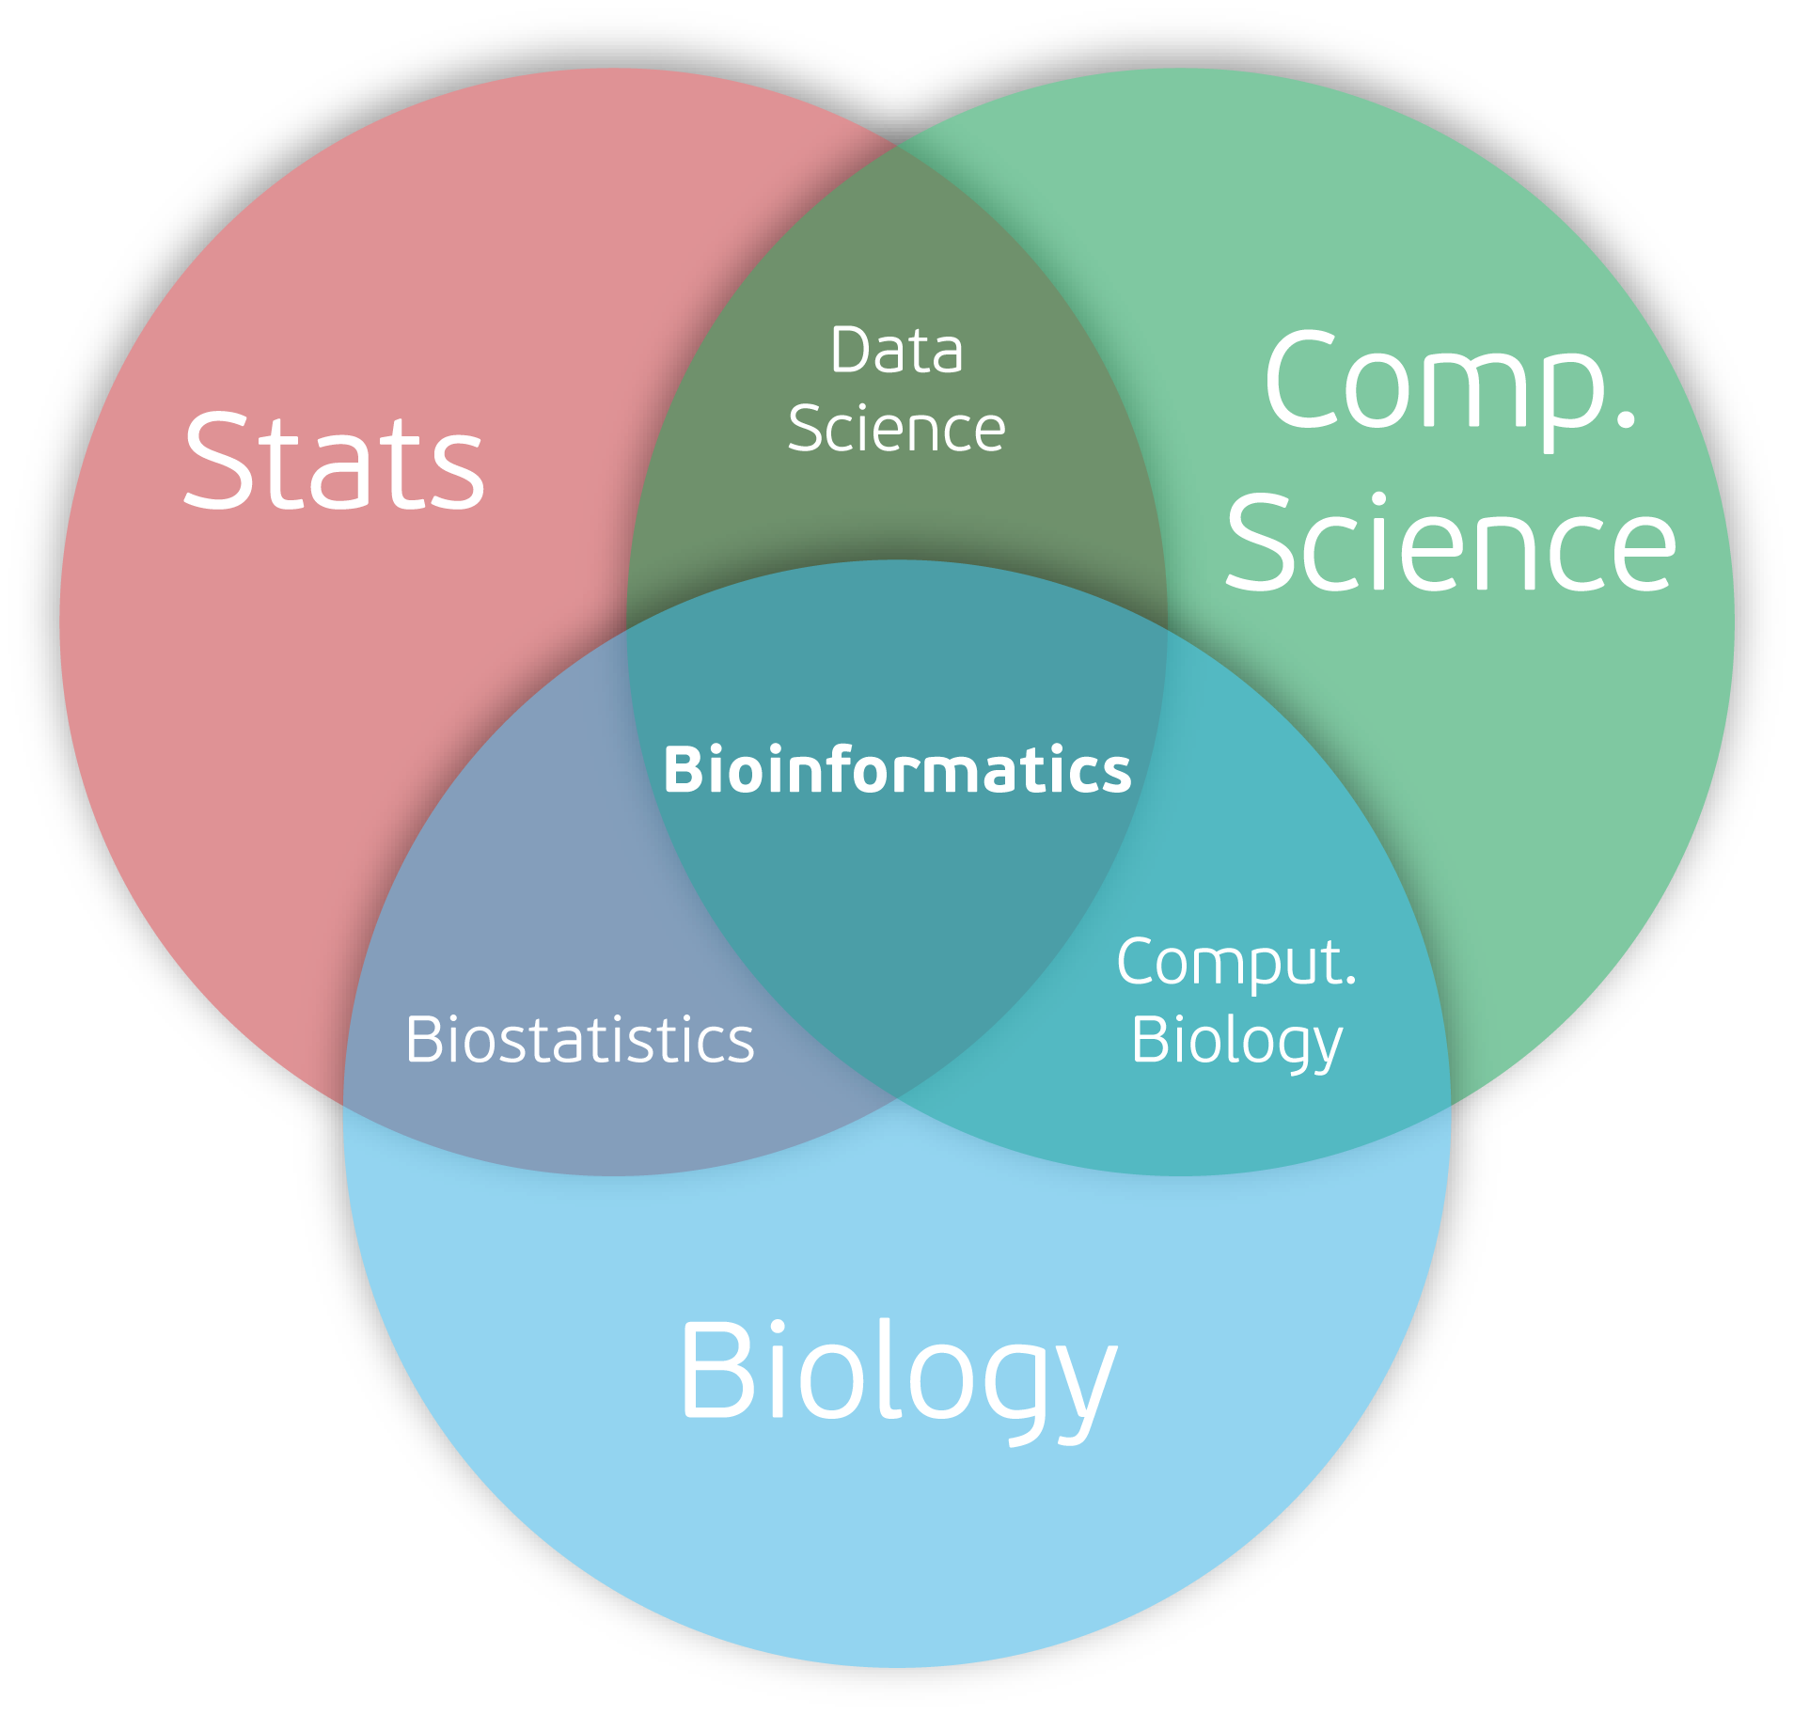
What is bioinformatics?

Slide 8

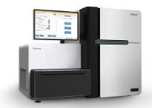
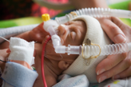
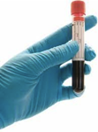
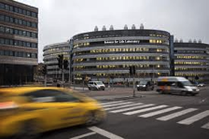
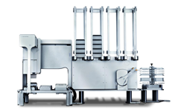
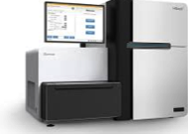
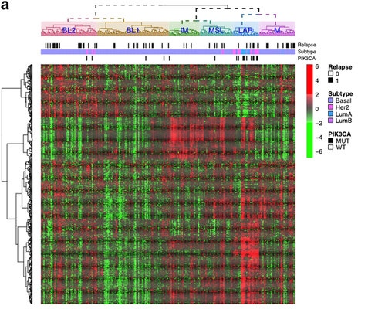

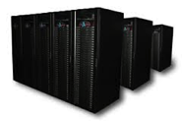

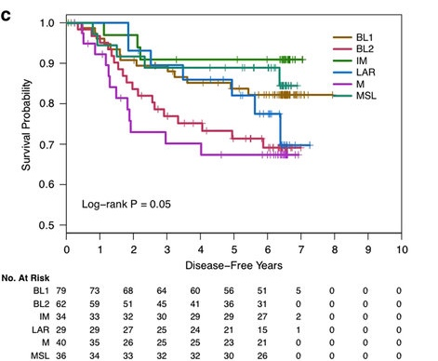
Example support project
Delivery to SciLifeLab
Manual or Automated
library preparations
Sequencing
HPC cluster for data processing
“The molecular landscape of high-risk early breast cancer: comprehensive biomarker analysis of a phase III adjuvant population.” http://www.nature.com/articles/npjbcancer201622

Slide 9
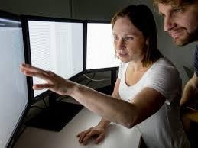
The Swedish Bioinformatics Advisory Program
PhD students get a senior bioinformatician as a personal advisor during 2 years of their PhD. Monthly project meetings + two grand meetings per year to aid networking and knowledge transfer.
www.scilifelab.se/education/mentorship/the-swedish-bioinformatics-advisory-program/

Slide 10

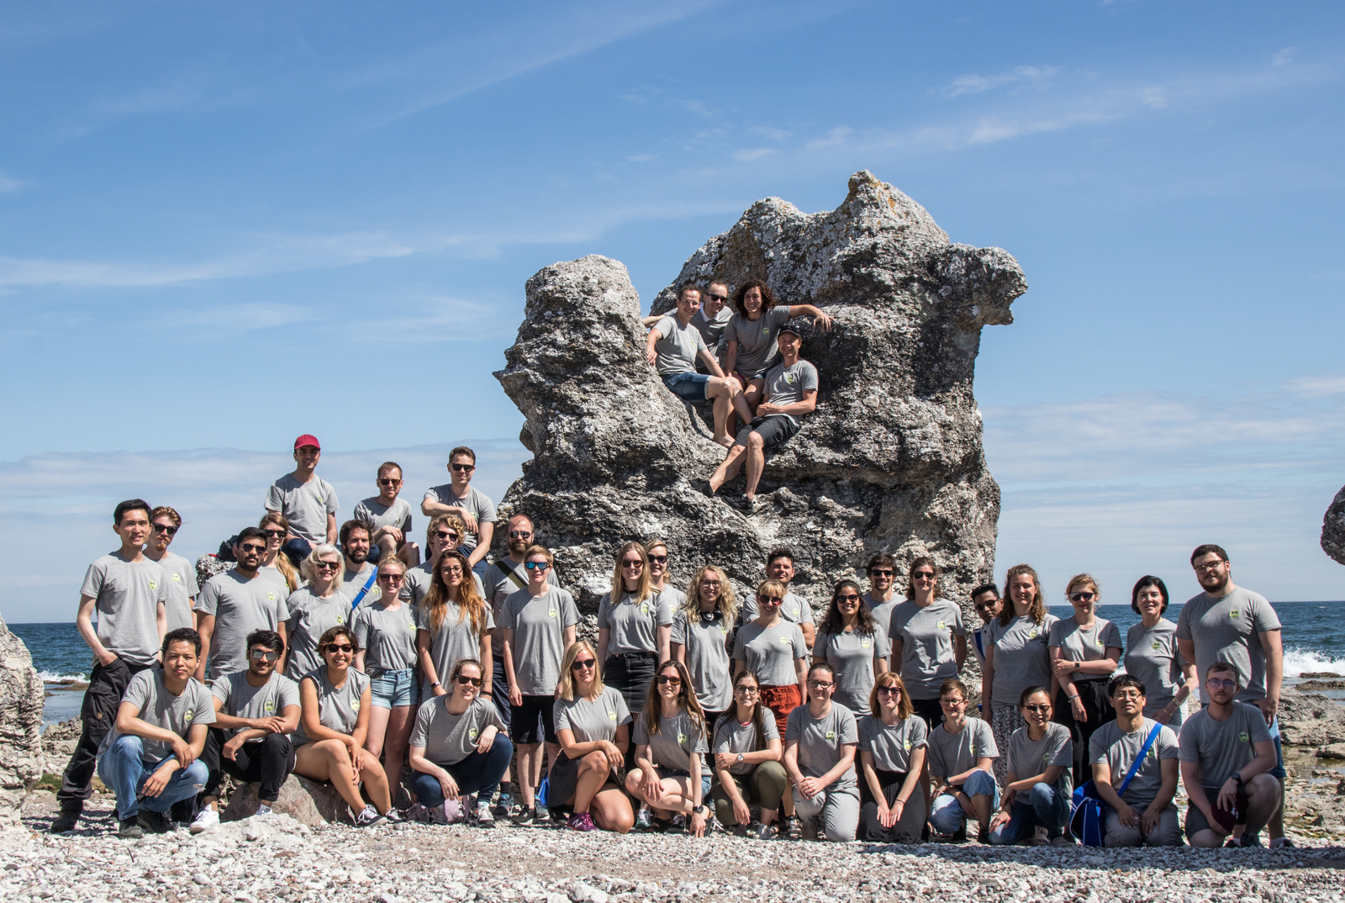
RaukR
Advanced R for Bioinformatics Summer School
R programming
Some focus on bioinformatics related topics
International

Slide 11

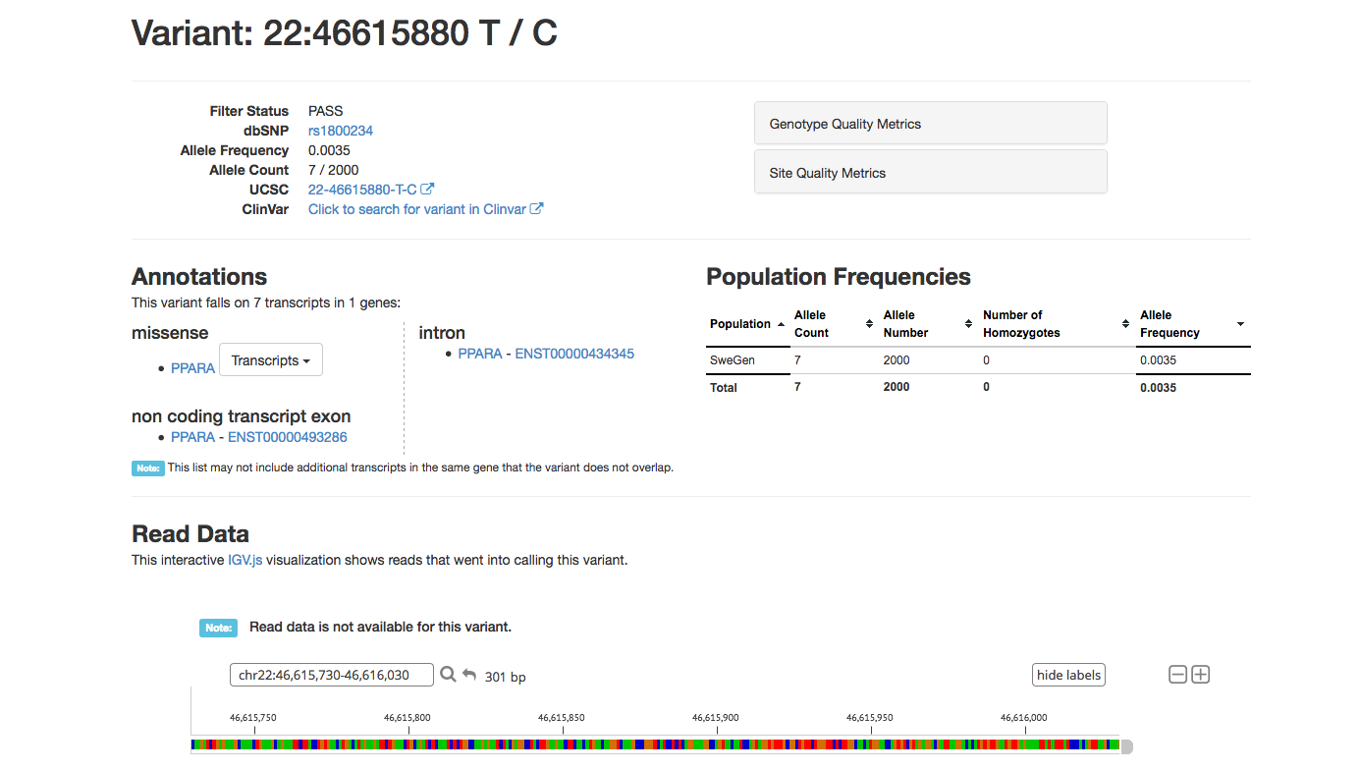
SweGen
SweGen Variant Frequency Database
950 twin registry + 50 Northern Sweden
WGS (30X)
ExAC browser interface
Data Beacon
Full SNP frequency table download
https://swefreq.nbis.se/
Funding: SciLifeLab
Sequencing: NGI
Variant calling: NGI
QC: NBIS
Data access interface: NBIS
11

Slide 12
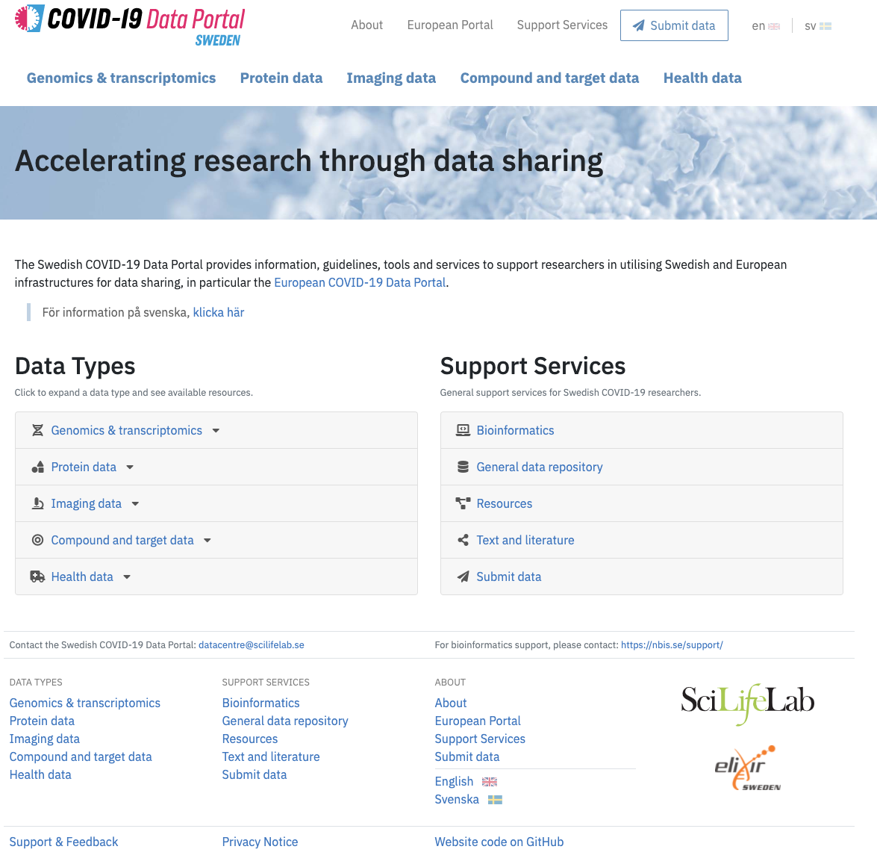
Covid19Portal
https://covid19dataportal.se/

Slide 13

Thanks for listening!

